Slide 1
Key words for chapter 21~22
Electric Charge
Point charge
Conductor
Insulator
Semiconductor
Superconductor
Coulomb
Coulomb’s law
Permittivity constant
Superposition
Proton
Neutron
Neutralize
Electron
Electric filed
Shell theorem
Electrostatic
Polarization
Elementary charge
Quantized
Electrostatic force
Repulsion
Attraction
Rod，Sheet，Disk，Ring
Spherical
Electric dipole
Electric dipole moment
Notes:
Again, Those are some of words within those two chapters, please be sure to be familiar with them, because you know, any question about language can not be replied in your quiz.

Slide 2
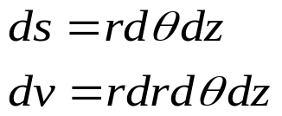
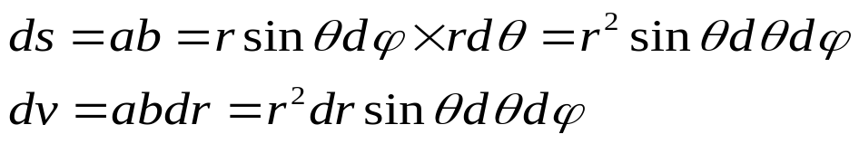
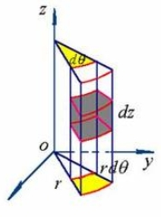
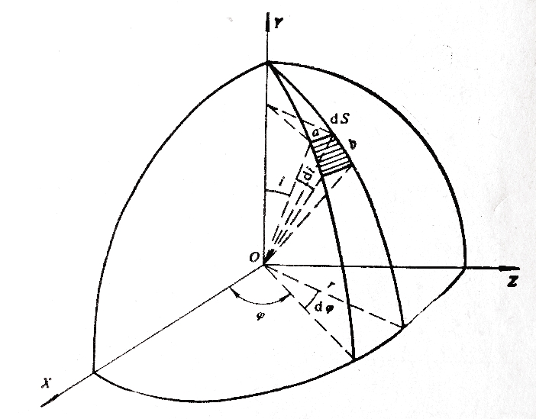
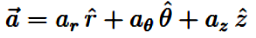
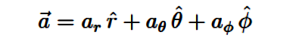
Coordinate systems
Cylindrical Coordinate
Spherical Coordinate

Slide 3

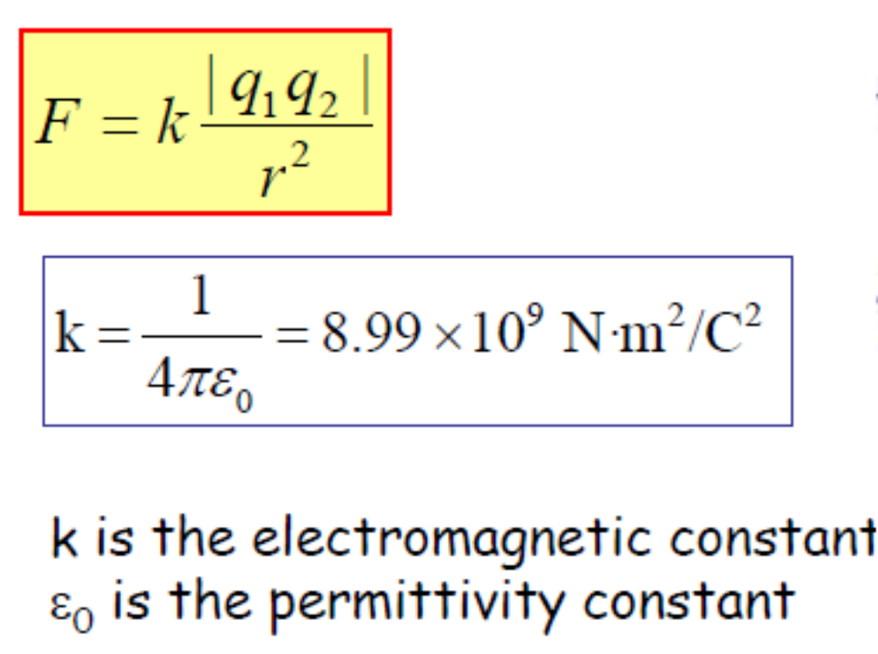
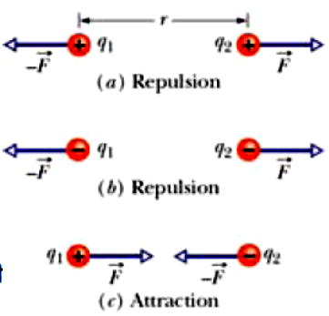
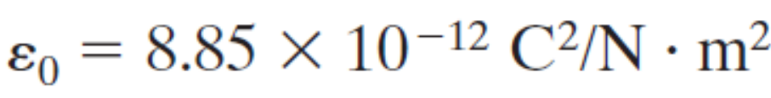
Coulomb’s law (库伦定律 )
(介电常数，电容率)

Slide 4
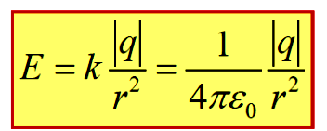
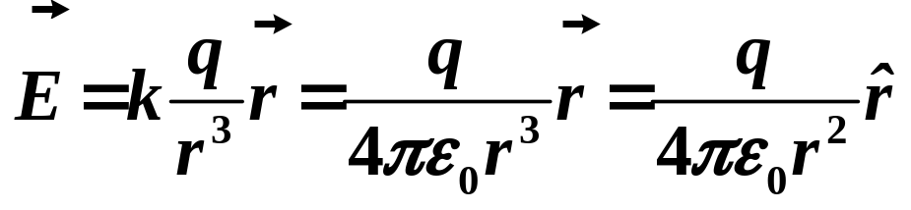
The electric field due to a point charge
The magnitude of the electric field from a point charge is:
Vector form :

Slide 5
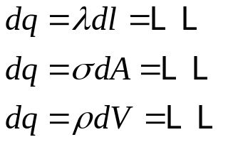
E field due to a continuous charge distribution
Calculate the E field created at point P by a continuous charge distribution by integration:
1, divide the charge into proper charge elements
2, Write the E field at point P due to an arbitrary charge element
3, Sometimes the symmetry of the charge distribution can simplify our calculation
4, Write dq in terms of the charge density and geometry element:
write the components of the E filed, the “r”, the interval etc. to get the integration expression.
5, do the integration.

Slide 6
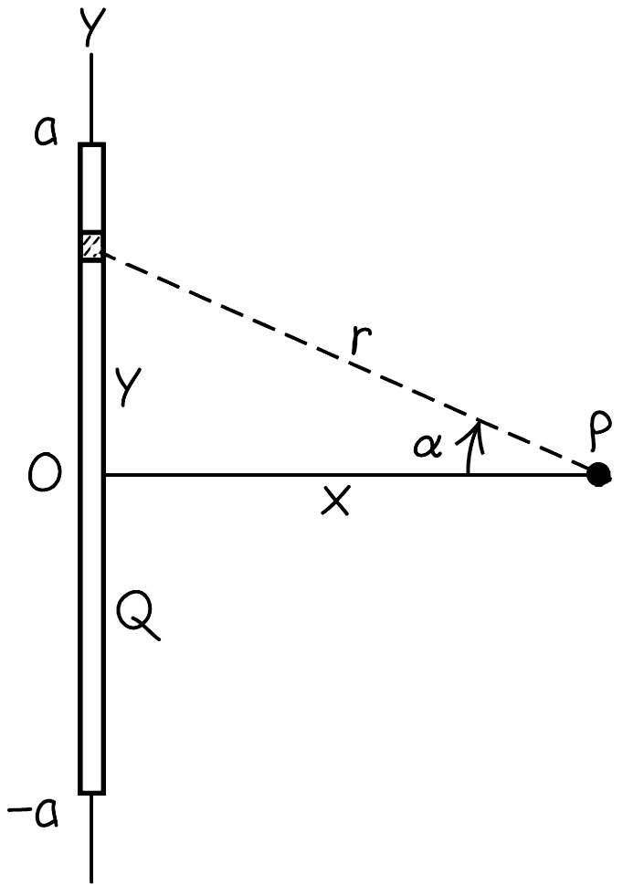
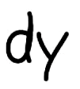
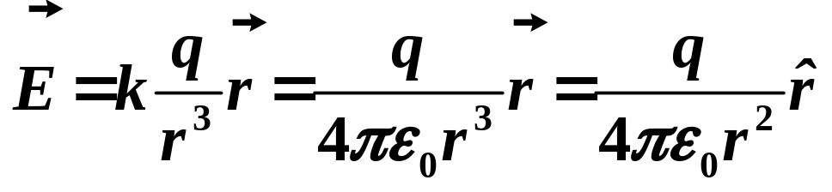


Electric field due to a charged line
Linear charge density is

Slide 7


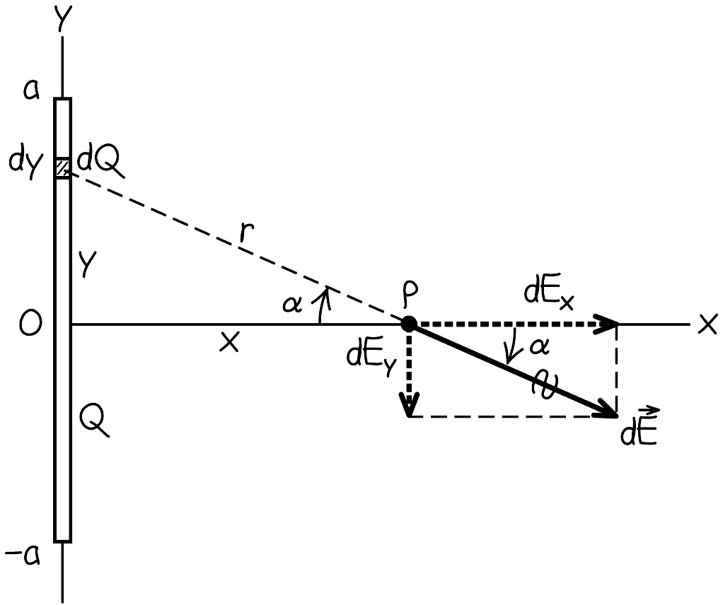




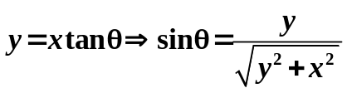
Electric field due to a charged line
(Even function)

Slide 8

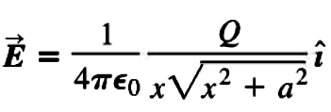





Electric field
Electric field due to a charged line
Vector form :
If x >> a:
(Point charge)
If a >> x:
Scalar form:

Slide 9

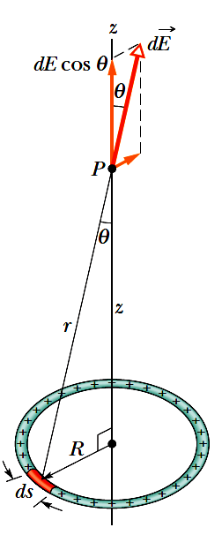

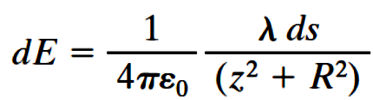
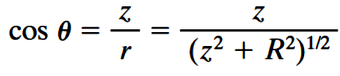

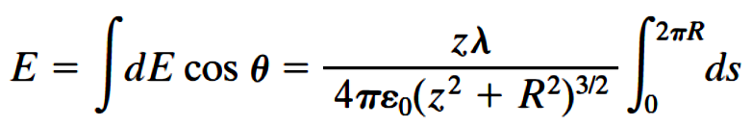
Electric field due to a uniform charged ring
λ is the charge per unit (arc) length
Notes:
In chapter 22, we have learned how to calculate the electric field at a point P produced by a charge distribution having regular shape. Obviously, the charge distribution can not be considered as a point charge if the distance, for example, here z is comparable with the length of charge R. At this case, we have to divide the charge into many tiny charges, each we called differential charge or charge element dq, we write down the electric field produced by the charge element, and give the expression of dq and r. we relate dq to differential length for one dimension case, differential area for two dimension case and differential volume to three dimension case. At last we add all the E field created by all the charge elements, that is integration. Here keep in mind, the E field is a vector, we have to decompose it into components, then we do the integration for each component.

Slide 10

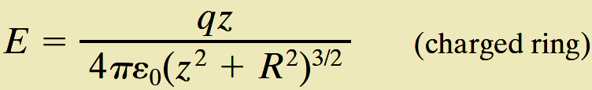

Electric field due to a uniform charged ring
if z >> R
(Point charge)

Slide 11
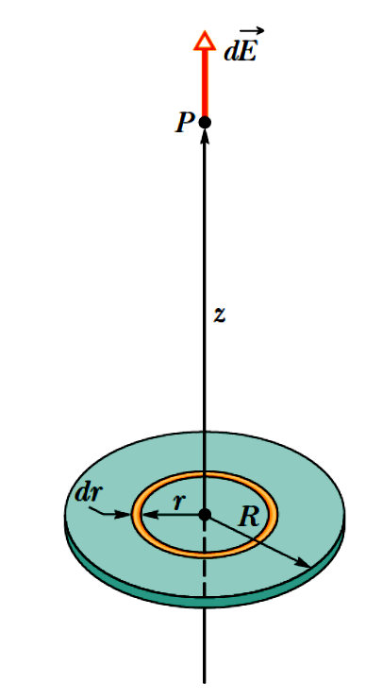

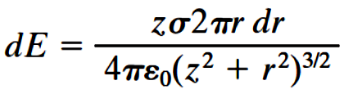
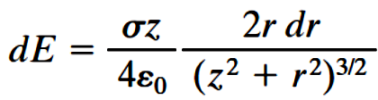
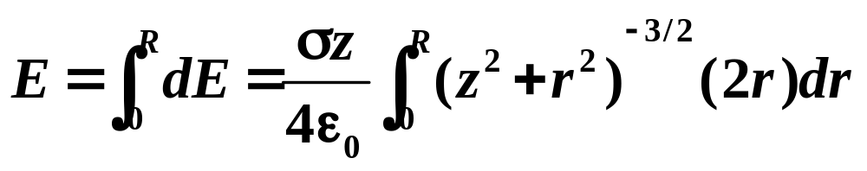
Electric field due to a uniform charged disk
Charged ring:

Slide 12




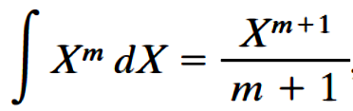
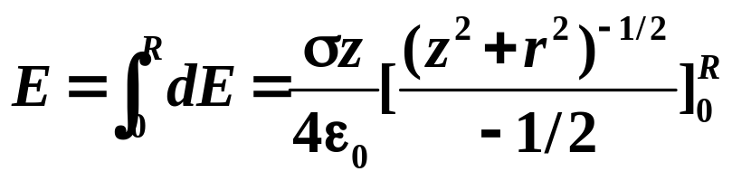
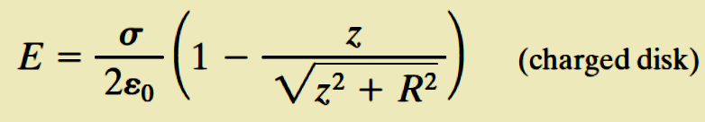
Electric field due to a uniform charged disk

Slide 13
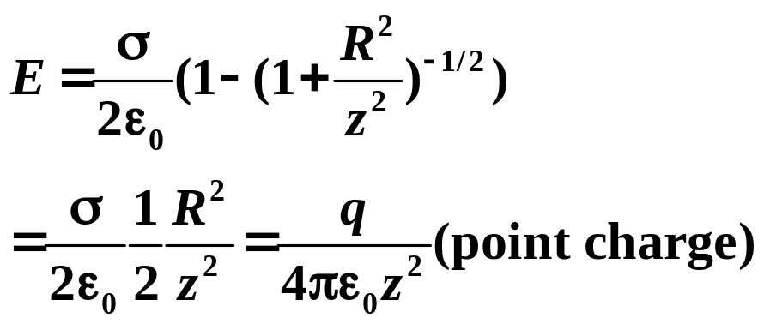

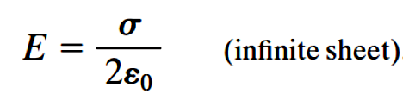

Electric field due to a uniform charged disk

Slide 14

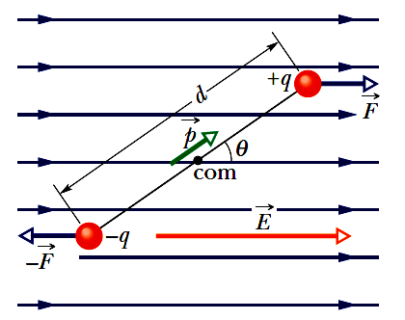


Dipole
Holds even not on the dipole axis
Varies as
Notes:
Here, dipole is composed by two charges with same charge magnitude but different sign, the distance between the two charge is d, then we can define the electric dipole moment p
This p is a vector, magnitude is qd and direction, pointing from negative to positive. If the dipole is put into a uniform electric field, there are no other external forces on the dipole, except the electric force, then energy of the dipole and electric system should be conservative, we can use the concept of energy conservation to solve problem.

Slide 15
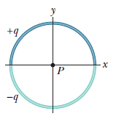
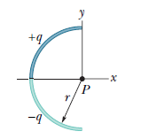
Problem 1
Two curved plastic rods, one of charge +q and the other of charge -q, form a circle of radius R = 8.50cm in an xy plane. The x axis passes through both of the connecting points, and the charge is distributed uniformly on both rods. If q =15.0pC, what are the (a)magnitude and (b) direction of the electric field at P, the center of the circle?
Notes:
Let’s do a exercise directly:

Slide 16


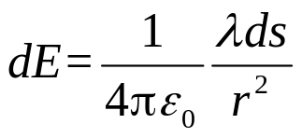
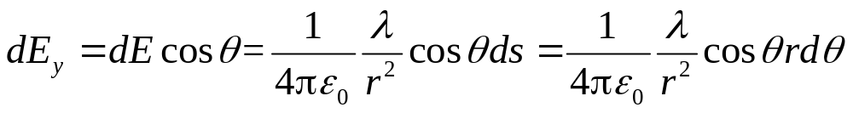
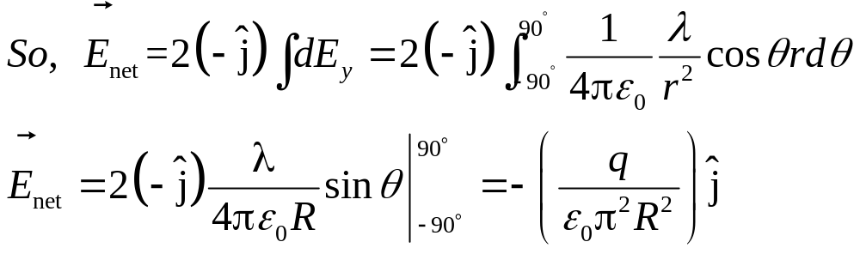

Problem 1
From symmetry, we see that the net field at P is twice the field caused by the upper semicircular charge
(and it points downward)
Consider a differential element having arc length ds,
Our element produces a differential electric field at point P
we need sum (via integration) only the y components of the differential electric fields set up by all the differential elements of the rod.
(a)

Slide 17
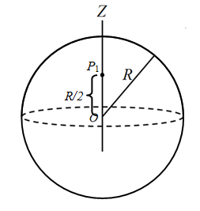
Problem 2
r
A spherical shell has radius R and uniform surface charge density σ as shown in figure. Start from the E field due to a uniform thin on the central axis to derive the E field inside and outside of it?

Slide 18
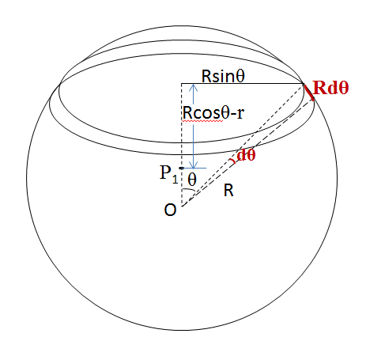
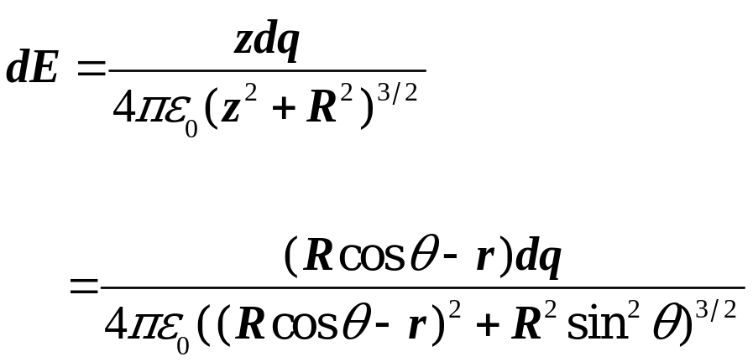
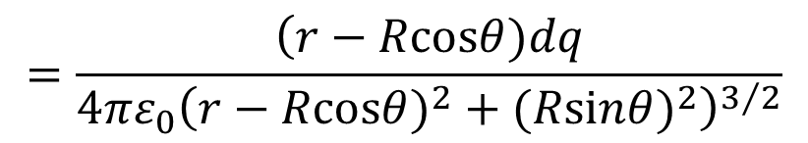
Problem 2
a) Find E field inside of it (at point P₁) ?
r
We can divide the spherical shell into many tiny rings.
For each ring, we have calculated the E field created by it at the point P₁ setting on its central axis, if we choose an arbitrary ring as show in figure, the tiny charge of this ring is dq and the magnitude of E field at point P₁ created by this ring is:
General expression

Slide 19
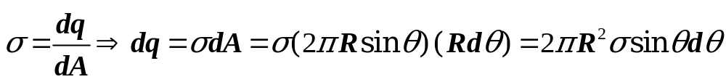
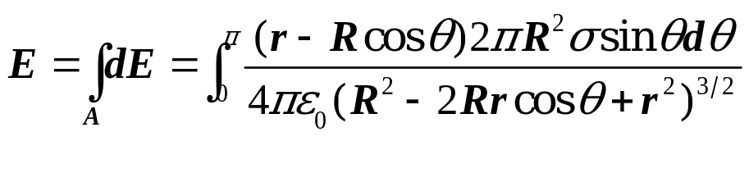
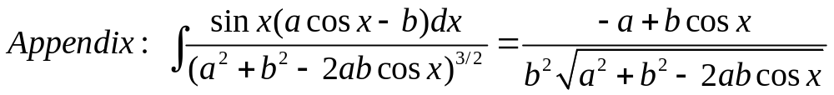
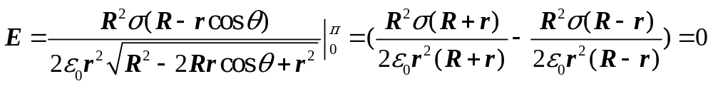
Problem 2
a) Find E field inside of it (at point P₁) ?

Slide 20
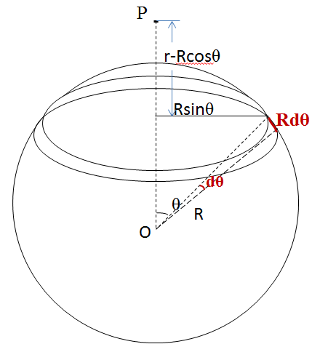
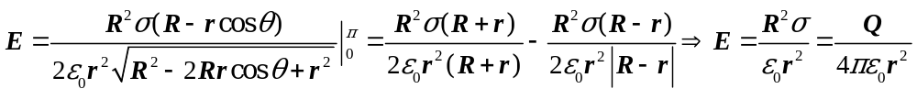
Problem 2
b) Find E field outside of it (at point P) ?

